Slide 1
Race and Self-Care Behaviors in US Elderly Adult Diabetics
Miao Cai, Hung-Yuan(Peter) Chen, Asabe Garba, Cheng-You Tsai
BST-5420 Complex Survey Project
Instructor: Dr. Steven Rigdon
May 07, 2019

Slide 2
Introduction
Diabetes has been the 7th leading cause of death in the U.S.
25% of adults ages 65 and older make up the US diabetic population.
People with diabetes are at increased risk of serious health complications including vision loss; amputation of toes, feet, or legs; heart disease; and kidney failure.
Diabetes can be managed through physical activity, diet, use of insulin, and other medications that regulate blood sugar levels.
In 2015, the rates of diabetes found in Non-Hispanic Blacks (12.7%), American Indians/Alaska Natives (15.1%), Hispanics (12.1%), Asians (8.0%) was much higher than that of Non-Hispanic Whites (7.4%).
Self-care behavior refers to “the decisions and actions that an individual can take to cope with a health problem or to improve his or her health.
Although U.S. adults age 65 and older are the predominant population that has diabetes, few studies have assessed their self-care behaviors.

Slide 3
Research Aim
Further research is needed to look at sociodemographic factors and self-care behaviors of different US racial/ethnic groups ages 65 and older.
Using 2017 data from the Behavioral Risk Factor Surveillance System (BRFSS), the objective of our study was to determine if race predicts the diabetic self-care behaviors of elderly U.S. adults.

Slide 4
Data Source
Data: 2017 Behavioral Risk Factor Surveillance System (BRFSS)
The BRFSS is a statewide data collection program from the 50 states, the District of Columbia, and Puerto Rico via monthly telephone interviews that is designed to measure behavioral risk factors for people 18 years of age or older.
450,016 total records
Age 65 years and older with a diabetes diagnosis: 32,950 respondents.

Slide 5
Dependent Variables
Five diabetes self-care behaviors:
Diabetes Education
Physical Activity
Feet Check
Eye Exam
Blood Glucose use
Composite Variable: adding up the five self-care behaviors

Slide 6
Independent Variables
Races: non-Hispanic white, non-Hispanic black, Hispanic, and non-Hispanic other
Age: 65-69, 70-74, 75-79, and more than 79 years old
Marital status: married, divorced/widowed/separated, and never married
Education: less than high school, high school graduate, some college, and college graduate
Income level: less than $15,000, $15,000 to less than $25,000, $25,000 to less than $35,000, $35,000 to less than $50,000, and $50,000+
BMI: underweight, normal weight, overweight, and obese.
Health status: excellent/very good, good, and fair/poor.

Slide 7
More Independent Variables
Insurance
Regular providers
Insulin use
Smoking
Chronic conditions:
Coronary heart disease
Chronic kidney disease
Chronic heart attack
High cholesterol level
Hypertension

Slide 8
Statistical Analyses
Means and standard errors to describe the dependent variables and independent variables in the population
The number of different types of diabetes self-care behaviors: Poisson regression
The complex survey design was accounted for using the R package survey.
brfssdsgn <- svydesign(id=~1, strata = ~ `_STSTR`,
weights = ~ `_LLCPWT`, data = your_data)
svyglm(Y ~ X, design = brfssdsgn, family=quasipoisson())

Slide 9
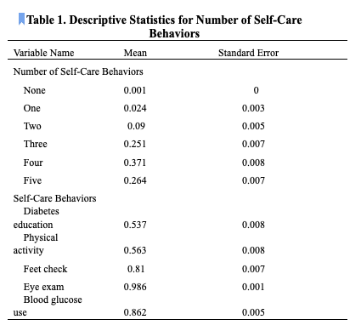
Results

Slide 10
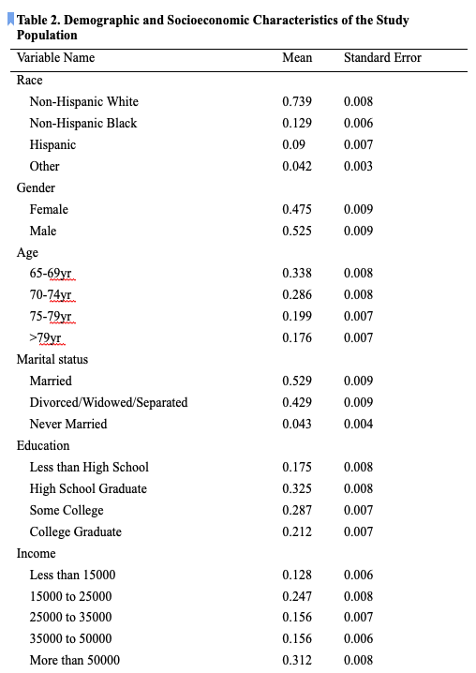
Results

Slide 11

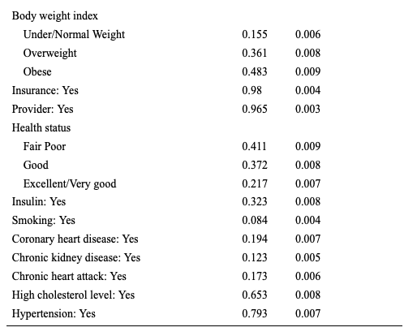
Results

Slide 12
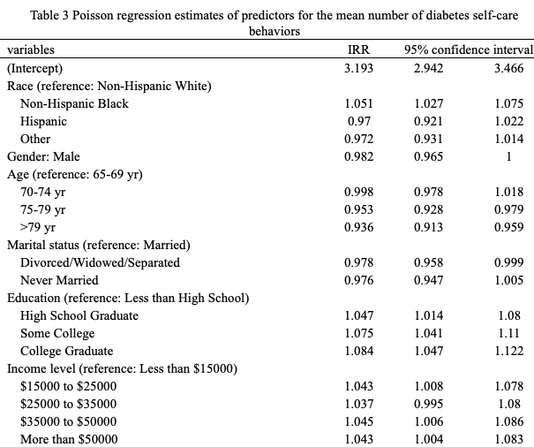
Results

Slide 13

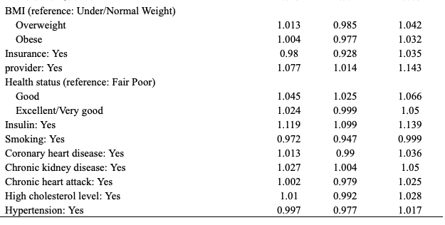
Results

Slide 14
Discussion
Majority of respondents practiced four self-care behaviors.
Past studies had also looked at how diabetes management varies across different demographic variables.
Used diabetes education and blood glucose monitoring as the determinants of diabetes management and found that disparities in diabetes management existed based on socioeconomic status.
Found significant differences in the self-care behaviors of Non-Hispanic Blacks compared to Non-Hispanic Whites.
Blacks more likely than Hispanics and other racial groups to engage in a higher mean number of self-care behaviors.
Respondents in the higher income level ranges ($35000 to $50000; more than $50000) had higher mean number of self-care behaviors than lower income level ranges (less than $15,000).
College graduates had higher mean number of self-care behaviors than other education levels.

Slide 15
Discussion
Strengths
Used BRFSS Data
Nationally representative collection of health survey results that has been validated for its reliability and accuracy.
Large sample size allowed us to detect any differences that may exist between the categories of self-care behaviors.
One of few studies that have created self-care categories in order to determine the relationship that exists between race and how well elderly adults manage their diabetes.

Slide 16
Discussion
Limitations
Used self-reported data which may bias our results due to recall bias.
Our study sample was not truly representative of the U.S. diabetic population since the respondents in this sample had a higher SES.
Large percent had insurance and a healthcare provider, which would result in better diabetes management.
Self-care behaviors used for diabetes management were based on the availability of relevant diabetes questions included in the BRFSS survey questions.
Cross-sectional study, so we cannot make any casual projections from our findings.

Slide 17
Discussion
Public Health Implications
Results can be used to help inform primary and secondary preventative measures for diabetes that are promoted by healthcare professionals.
Results can also be used to help develop interventions that are better catered towards the elderly adults that will help overcome any social barriers that exist for better diabetes management.
This will eventually help lead to a reduction in the prevalence and economic burden of diabetes reported annually in the U.S.

Slide 18
Conclusion
We found that there were significant differences in the self-care behaviors of Non-Hispanic Blacks compared to Non-Hispanic Whites. In addition, Blacks were more likely than Hispanics and other racial groups to engage in a higher mean number of self-care behaviors.
Race, marital status, education, healthcare provider and health status were associated with diabetes management.
Future studies should further explore how increased access to healthcare resources influences diabetes management and thus self-care behaviors in different elderly racial groups.

Slide 19
References
1. CDC, New CDC Report: More than 100 million Americans have diabetes or prediabetes. Last modified July, 2017. 18: p. 2017.
2. Bohanny, W., et al., Health literacy, self-efficacy, and self-care behaviors in patients with type 2 diabetes mellitus. J Am Assoc Nurse Pract, 2013. 25(9): p. 495-502.
3. Pletcher, P. Type 2 Diabetes Statistics and Facts. 2014; Available from: http://www.healthline.com/health/type-2-diabetes/statistics.
4. Powers, M.A., et al., Diabetes Self-management Education and Support in Type 2 Diabetes: A Joint Position Statement of the American Diabetes Association, the American Association of Diabetes Educators, and the Academy of Nutrition and Dietetics. Clin Diabetes, 2016. 34(2): p. 70-80.
5. Piper, C.N., et al., Racial influences on diabetes management among adults in North Carolina. Ethn Dis, 2013. 23(3): p. 316-21.
6. Kirkman, M.S., et al., Diabetes in older adults. Diabetes care, 2012. 35(12): p. 2650-2664.
7. Kirkman, M.S., et al., Diabetes in older adults. Diabetes Care, 2012. 35(12): p. 2650-64.
8. Glasgow, R.E., D.J. Toobert, and C.D. Gillette, Psychosocial barriers to diabetes self-management and quality of life. Diabetes spectrum, 2001. 14(1): p. 33-41.

Slide 20
References
9. Haller, M.J., M.S. Stalvey, and J.H. Silverstein, Predictors of control of diabetes: monitoring may be the key. J Pediatr, 2004. 144(5): p. 660-1.
10. Julin, B., et al., Association between sociodemographic determinants and health outcomes in individuals with type 2 diabetes mellitus in Sweden. Diabetes Metab Res Rev, 2018.
11. Vaccaro, J.A., K. Anderson, and F.G. Huffman, Diabetes Self-management Behaviors, Medical Care, Glycemic Control, and Self-rated Health in US Men by Race/Ethnicity. American journal of men's health, 2016. 10(6): p. NP99-NP108.
12. BRFSS. Behavioral Risk Factor Surveillance System: Overview 2017. 2017; Available from: https://www.cdc.gov/brfss/annual_data/2017/pdf/overview-2017-508.pdf.
13. Nwasuruba, C., M. Khan, and L.E. Egede, Racial/ethnic differences in multiple self-care behaviors in adults with diabetes. J Gen Intern Med, 2007. 22(1): p. 115-20.
14. Nwasuruba, C., et al., Racial differences in diabetes self-management and quality of care in Texas. J Diabetes Complications, 2009. 23(2): p. 112-8.
15. Association, A.D., Standards of Medical Care in Diabetes-2019 Abridged for Primary Care Providers. Clinical diabetes: a publication of the American Diabetes Association, 2019. 37(1): p. 11.
16. Team, R.C., R: A language and environment for statistical computing. 2013.
17. Lumley, T., Analysis of complex survey samples. Journal of Statistical Software, 2004. 9(1): p. 1-19.

Slide 21
THANK YOU!

Slide 22
Questions?

